Slide 1
Data Structures and Algorithms
Notes:
Manav Rachna College of Engineering

Slide 2
SOME QUESTION FOR U !!!!!!!!!!!!!
Why are we studying any programming language???.
Advantage and disadvantage of the languages u have studied earlier??
What do you think efficiency of the program depends on??
What is your approach of solving a particular problem??
Do you know anything about data structures????

Slide 3
Do u think efficiency of the program will be effected if data is not stored properly???

Slide 4
COURSE OBJECTIVES:
To understand the standard data representation methods.
To acquaint with the structural constraints and advantages in usage of the data.
To understand the memory requirement for various data structures.
To operate on the various structured data.
To understand various data searching and sorting methods with pros and cons.
To understand various algorithmic strategies to approach the problem solution
Notes:
Manav Rachna College of Engineering

Slide 5
COURSE OUTCOMES
On completion of the course, student will be able to:
To discriminate the usage of various structures in approaching the problem solution.
To design the algorithms to solve the programming problems.
To use effective and efficient data structures in solving various Computer Engineering domain problems.
To analyze the problems to apply suitable algorithm and data structure.
To use appropriate algorithmic strategy for better efficiency.

Slide 6
Evaluation Scheme:
Credits: 04
Theory: 50 Marks
In Sem(Online):50 Marks
DS Lab
TW=25Marks
PR=50 Marks
Credit =04

Slide 7
Assessment Measures
Direct Measures
Unit Test
Assignments
Practical's

Slide 8
BOOKS
1.Brassard & Bratley, ―Fundamentals of Algorithmics, Prentice Hall India/Pearson Education, ISBN 13-9788120311312.
2. Horowitz and Sahani, ―Fundamentals of Data Structures in C++, University Press, ISBN 10: 0716782928 ISBN 13: 9780716782926.
3. Goodrich, Tamassia, Goldwasser, ―Data Structures and Algorithms in C++, Wiley publication, ISBN-978-81-265-1260-7.
4.Horowitz, Sahani and Rajshekaran, ―Fundamentals of Computer Algorithms, University Press, ISBN-13, 9788175152571.

Slide 9
UNIT -1
Introduction to Algorithm and Data Structures
Algorithms- flowchart, Pseudo code.
Analysis of Algorithms
Data Structures
Algorithmic Strategies.
Recurrence relation

Slide 10
PROBLEM TO SOLVE
Suppose we have to sort 10 Numbers.
or
suppose I want to bring something from market and have to lock my home before going ….
What do u think the steps I need to follow to solve this problem efficiently???

Slide 11
Important steps of problem solving
Select the appropriate data structure.
Design suitable algorithm.

Slide 12
So why are we studying this particular subject????????

Slide 13
DATA STRUCTURE
Data structure describes the way the data is organized, and stored in memory for convenient processing.
OR
Data Structure can be defined as a particular way of storing and organizing data in a computer so that it can be stored efficiently.

Slide 14
CONCEPT OF DATA STRUCTURE
Data must be organized for the following
basic reasons-:
  Suitable representation
  Ease of retrieval
  Operations allowed

Slide 15
So the overall performance of a program depends upon the following two factors:
Choice of right data structure.
Design of suitable algorithm to work upon the chosen data structure.

Slide 16
Choice of Right Data Structure
Let us consider the situation where it is required to create a merit list of 60 students (name, rollno, marks, percenatage and grade).
Choice I: Array
Choice II: Array of Structure

Slide 17
Choice 1:
0 1 2 3 59 60
name list
rollno
marks
percent
grade
Parallel list for student data

Slide 18
Choice II:
struct student
{
char name[15];
int roll;
int marks;
float percent;
char grade;
}s[10];
What are data objects???

Slide 19
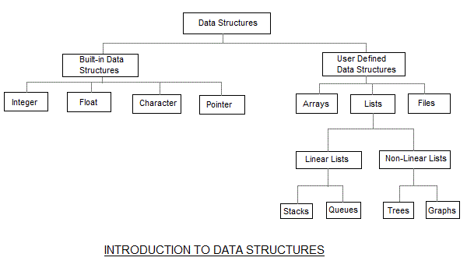
TYPE OF DATA STRUCTURES

Slide 20
Primitive D.S
Basic data types such as int, char, float are known as Primitive D.S or built in D.S
Eg. int, char, float.
Non Primitive D.S
That data types that are derived from primary data structures are known as Non Primitive D.S or user defined D.S. They are used to store groups of values.
Eg. array, structure, union, link list, stack, queues etc..

Slide 21
Linear List
These represents a sequence of items and the elements follow a linear ordering.
The Linear D.S has following properties:
  Each element is followed by one other
  element.
  No two elements are followed by the same
  element.

Slide 22
Types Of Linear Lists:
ARRAYS:
An array is used to store elements of the same type.
The number of elements that can be stored in a array can be calculated as-
  (upperbound-lowerbound)+1
  int a[10]
1 | 2 | 3 | 4 | 5 | 6 | 7 | 8 | 9 | 10
a[0] a[1] ----- ---------------- -------------------------------- -a[9]

Slide 23
STACKS
Collection of elements like array with a special feature that deletion and insertion of elements can be done only from one end, called the TOP (Top of stack). Due to this property it is also called LIFO data structure i.e. Last-In-First-Out data structure.
Push an
Element 3
3
2
1

Slide 24
QUEUES
Queues are First -In-First-Out (FIFO) data. In a queue new elements are added to the queue from one end called Rear end, and the elements are deleted from another end called Front end. Eg. the queue in a ticket counter.
FRONT
REAR
B
A
E
C
D

Slide 25
LINK LIST
A link list is a linear collection of elements called nodes. The linear order is maintained by pointers. Each node is divided into two or more parts; one data field and another pointer field.
NULL
START
10
10
10
10
Data
3352
Data
5689
Data
1012
Data
2403
3352
5689
1012

Slide 26
STRUCTURE
  Collections of related variables (aggregates) of under one name.
  Can contain variables of different data types
  Commonly used to define records to be stored in files
Eg. struct ADate
{
int month;
int day;
int year;
} Date;

Slide 27
Types of Non Linear Lists
TREES
A tree can be defined as finite set of data items called nodes.
Trees are non linear type of data structures in which data items are arranged or stored in a sorted sequence.
It represents the hierarchical relationship between various elements.
There is a special data item at the top called Root of tree.
A
ROOT
B
C
D
E
F

Slide 28
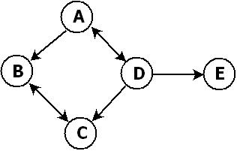
GRAPHS
Graph is non-linear data structure capable of representing kinds of physical structures.
A graph G(V,E) is a set of vertices V and a set of edges E connecting vertices.

Slide 29
ARRAY
Write a program to reverse an array

Slide 30
PROBLEM STATEMENT
Create a structure Student containing name, rollno, marks in 5 subjects. Allow user to enter details of five students. Calculate the % of each student and display the details of first two toppers.

Slide 31
Problem statement
Create an structure Account that the bank might use to represent customer bank accounts. Include the data members Name, Account number and Account balance. Provide three member functions in a class, member function Credit() should add an amount to current balance and member function Debit() should withdraw the money from the account and ensures that the debit amount does not exceed the account’s balance. If it does, the balance should left unchanged and the function should print a message indicating “ Debit Amount Exceeded Account Balance “. Member function getBalance() should display the current balance with customers information . Create a Program that display information of five Customers.

Slide 32
HOME ASSIGNMENT
Design a structure BIGBAZAR to store order information. Each order information has an 11-character item code, 20- character item name, price and an integer quantity. Provide the following member functions in a class:-
  1. functions to read these records from standard input getdata(),
  2. to calculate the total price calculate()
  3. sort functions to arrange data by ItemCode sort(),
  4. to dispay the same and display the totalprice display().
  Also use function displaycount() to display the number of records.

Slide 33
ALGORITHM
An Algorithm, can be defined as a finite sequence of instructions, that if followed accomplishes a particular task.

Slide 34
HOW TO DEVELOP AN ALGORITHM
Understand the problem.
Identify the output of the problem.
3. Identify inputs required by the problem and choose the associated data structure.
4. Design a logic that will produce the desired output from the given inputs.
5. Test the algorithm for different sets of input data.
6. Repeat steps 1 to 5 till the algorithm produces the desired results for all types of input and rules.

Slide 35
CHARACTERISTICS OF AN ALGORITHM
INPUT: This part of the algorithm reads the data of the given problem.
DEFINITENESS: Each instruction is clear and unambiguous .for eg add 6 or 7 to x.
FINITENESS: The algorithm must come to an end after a finite number of steps.
EFFECTIVENESS:. It should also be basic enough to carried out with pencil and paper. Each instruction should be definite and feasible.
OUTPUT: It must produce the desired output.

Slide 36
ALGORITHM & PSEUDO CODE
An algorithm is a well-defined procedure that allows a computer to solve a problem.
Pseudocode is a simple way of writing programming code in English.
Pseudocode is not an actual programming language. It uses short phrases to write code for programs before you actually create it in a specific language.
A program is a sequence of instructions in a particular programming language, written to perform a specified task on a computer.

Slide 37
PSEUDOCODE & ALGORITHM
Example 1:
Write an algorithm to determine a student’s final grade and indicate whether it is passing or failing. The final grade is calculated as the average of four marks.

Slide 38
PSEUDOCODE & ALGORITHM
Algorithm
Input a set of 4 marks
Calculate their average by summing and dividing by 4
if average is below 60
Print “FAIL”
else
Print “PASS”

Slide 39
PSEUDOCODE & ALGORITHM
Pseudocode
1: read M1,M2,M3,M4
2: GRADE := (M1+M2+M3+M4)/4
3: if (GRADE < 60) then
write “FAIL”
4. else
write “PASS”

Slide 40
SELECTION SORT, WE CAN WRITE ITS ALGORITHM
Selection Sort, we can write its algorithm..
First it finds the smallest element in the array.
Exchange that smallest element with the element at the first position.
Then find the second smallest element and exchange that element with the element at the second position.
This process continues until the complete array is sorted.

Slide 41
THE PSUEDOCODE FOR ABOVE ALGORITHM
SELECTION-SORT(A)
1. for j := 1 to n-1
2. smallest := j
3. for i := j + 1 to n
4. if A[ i ] < A[ smallest ]
5. smallest ← i
6. Exchange A[ j ] ↔ A[ smallest ]

Slide 42
ALGORITHM SPECIFICATIONS
Pseudo code conventions
1.Comments begin with //and continue until the end of line
2.Blocks are indicated by { } and statements are delimited by ;
3.Identifiers begins with letter. Data types are not explicitly declared. The type will be clear from context .
4.Global and local will also be clear from context

Slide 43
5.Assignment operator is used for assigning.
A:=3;
6.Boolean values used are true and false
Logical operators- and,or,not
All Relational operators are used.
>,<,=,≥,≤,≠
7.Elements of 1D &2D array are accessed using A[i]& A[i, j] respectively.Array index start from 0.
8. while(condition) do
{--- }

Slide 44
9. repeat
---------------
---------------
until(condition);
10.for i:=1 to 5 do
{
}
11. if condition then statement else statement;
case{
:condition1:statement
:condition2:statement
else:statement
}

Slide 45
12.Input and output is done using instruction read and write
13.Algorithm Max(A,n)
{
}
Note:
Algorithm may or may not return any value.
Simple variables in procedure are passed by value .
Array and record name is treated as pointers

Slide 46
Designing an Algorithm
SEQUENCE STRUCTURE:
Pseudocode to compute area of rectangle
Algorithm AreaRect( l, b, area)
{ // l is length of rectangle, b is breadth of
// rectangle and area will hold the calculated
// area of rectangle.
1. read l, b;
2. area := l*b;
3. write area;
}

Slide 47
SELECTION (conditional control)
Algorithm to find greatest of 3 numbers
Algorithm greatest(num1,num2,num3,res)
{ //num1, num2, num3 are 3 nos. to be compared
//and res will hold the largest value.
read num1,num2,num3;
if(num1>num2 and num1>num3)then res:=num1;
3 elseif(num2>num1 and num2>num3)then res:=num2;
4elseif(num3>num1 and num3>num2) then res:=num3;
5else res:=num1 ;
6.write res;
}

Slide 48
ITERATIONS (or repetitions)
Algorithm to find largest of 10 numbers
Algorithm largest ( A, n, large )
{ // A is an array of n nos. and large will hold the
//largest no.
1. read size of list n;
2.For i:=0 to n do
3 read A[i];
4. Set large := A[0]
5. for i:=1to n do
6. if (A[i]>large)
7. large := A[i]
8. write large;
}

Slide 49
Algorithm to calculate sum of even numbers present in a given list and also count the even numbers present in the list
Algorithm count_even(a,n,e_counter,sum)
{ // a is an array of n nos, a counter variable e_counter is used to
//count even nos in given list, variable sum will hold the sum of
// 10 nos
1.sum:=0,e_counter:=0;
2.read n;
3.for i:=0 to n do
3.1 read a[i];
4.for i:=0 to n do
4.1 if (a[i]%2= 0) then
4.1.1 write a[i] is even;
4.1.2 e_counter:=e_counter+1;
4.1.3 sum := sum+a[i];
5. write sum, e_counter
}

Slide 50
The variable acting as accumulator is SUM as it is holding sum of 10 nos
Counter variable is e_counter as it is counting no. of even nos in the list and i as it is counting the no of times operation is performed.

Slide 51
FLOWCHARTS
Graphically depict the logical steps to carry out a task and show how the steps relate to each other.

Slide 52
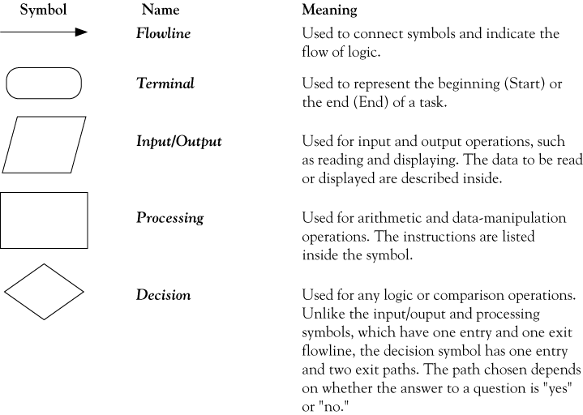
FLOWCHART SYMBOLS
connector
Used to join different flowlines

Slide 53
1. SEQUENCE
Statemement a
Statemement b
Statemement c

Slide 54
EXAMPLE ADD THREE NUMBERS
Start
Read
N1,N2,N3
Total=N1+N2+N3
Print total
Stop

Slide 55
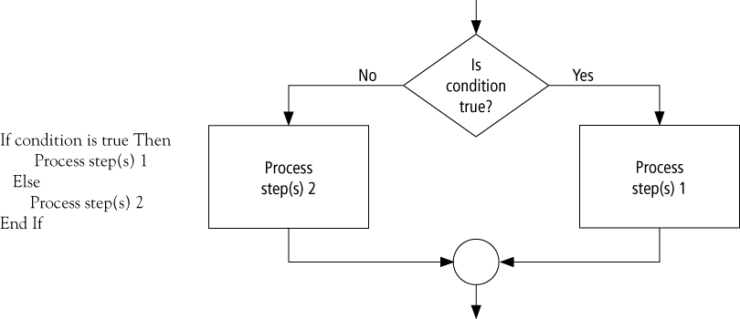
DECISION FLOW CHART

Slide 56
LARGEST OF TWO NUMBERS
START
Input
VALUE1,VALUE2
Y
is
VALUE1>VALUE2
N
MAX= VALUE1
MAX =VALUE2
Print“The largest value is”, MAX
STOP

Slide 57
NESTED IF STATEMENT
T
Record
Code =`A‘ ?
F
F
T
Record
Code =`A‘ ?
Increment
Counter_A
Record
Code =`A‘ ?
F
Increment
Counter_B
T
Increment
Error_counter
Increment
Counter_C

Slide 58
CASE STRUCTURE
Case
Of
variable
Value 1
Value 2
Value 3
Value 4
Statement_a
Statement_b
Statement_c
Statement_d

Slide 59
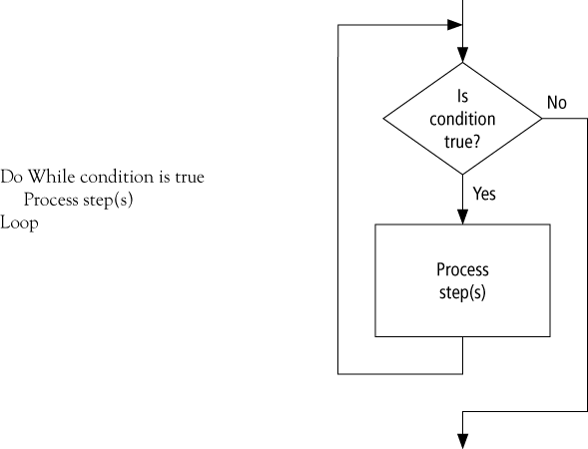
LOOPING FLOW CHART

Slide 60
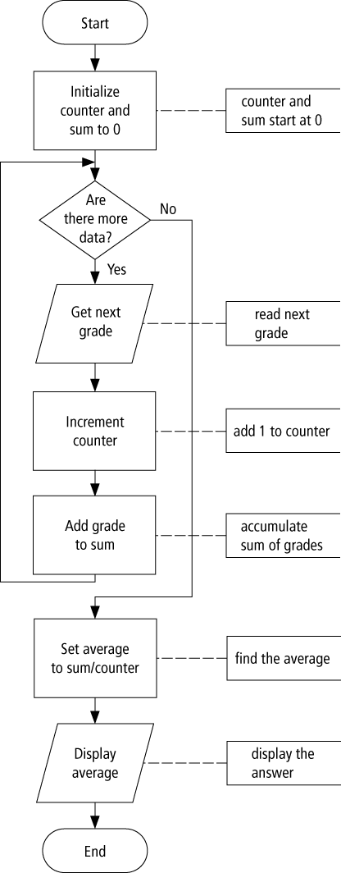
FLOWCHART

Slide 61
PRACTICE QUESTION
30 Candidates in engg. examination are required to take 5 single subject papers. For passing the exam, a candidate must score at least 35 in each subject and obtain an average of at least 40.The details each candidate i.e name,rno,m1,m2,m3,m4,m5 is stored in a file. Write a pseudo code to process a file and print the list of successful candidates with their rollno,name and total marks.

Slide 62
HOW TO ANALYZE ALGORITHMS
Problem statement: Given numbers m,n.Find Gcd
Algo1: GCD(m,n)
{
1.Factorize m such that m=m1*m2….
2.Factorize n such that n=n1*n2…
3.Identify common factors ,multiply and return result
}

Slide 63
Algo2:
Euclid(m,n)
{
while m does not divides n
{ r= n mod m
n=m
m=r
}
Return m;
}

Slide 64
EXAMPLE:
m=36
n=48
ALGO1:
m=2*2*3*3
n=2*2*2*2*3
Common Factors2*2*3
g.c.d 12
ALGO2:
r= 48%36
=12
n= 36
m=12
since now 12 divides 36 iteration ended
Gcd 12

Slide 65
Lets take 1 more example
M=434
N=966
Solve these using both algorithms

Slide 66

WHAT DO YOU CONCLUDE??
Which algorithm is better?

Slide 67
Note:
Counting iterations will be useful through out the course.

Slide 68
The algorithms are correct, but which is the best?
Measure the running time (number of operations needed).
Measure the amount of memory used.
Note that the running time of the algorithms increase as the size of the input increases.

Slide 69
ALGORITHM ANALYSIS
An algorithm requires following 2 resources:
Memory Space: Space occupied by program code and the associated data structures.
CPU Time: Time spent by the algorithm to solve the problem.
Thus an Algorithm can be analyzed on two accounts space and time.

Slide 70
Factors governing execution time of a program:
The speed of the computer system.
The structure of the program.
Quality of the compiler that has compiled the program.
The current load on the computer system.
It is thus better we compare the algorithm based on their relative time instead of actual execution time.

Slide 71
ROAD MAP FOR THE COURSE
Problem:
  Description of Input-Output relationship
Algorithm:
  A sequence of computational step that transform the input into the output.
Data Structure:
  An organized method of storing and retrieving data.
Our task:
  Given a problem, design a correct and good algorithm that solves it.

Slide 72
FRAMEWORK FOR ALGORITHM ANALYSIS
Basic Idea:
To study mathematical model of computer
Mentally Executes algorithm on computer model and evaluate time and not on real computer.

Slide 73
MATHEMATICAL MODEL OF COMPUTER
RAM model(Random Access Machine)
It has
Processor+ memory
Memory is a collection of locations
has one processor
executes one instruction at a time
each instruction takes "unit time“

Slide 74
INSTRUCTION SET OF PROCESSOR
One step execution
Arithmetic and logical operations allowed
A=b+c(1 step instruction)
Jump and conditional jumps
Goto
If(a>b)then goto
Pointer instruction
B=*c
Array operations
A[i]=b
B=c[i]

Slide 75
A=b + c*c-u ….3 steps in RAM model
A[i]=b[i]+c[i]
x=b[i]
Y=c[i]
z=X+y
A[I]=Z …4STEPS

Slide 76
Example
Algo: add(a[],b[])
{
for i=1 to n
C[i]=a[i]+b[i]
end for
}
Lets us convert in RAM model and check the no of instruction required.

Slide 77
Algo: add(a[],b[])
{
i=1
If(i>n) goto 9
x=a[i]
y=b[i]
z=x+y
c[i]=z
i=i+1
goto 2
}
total :1+n+1+b.n+2n=2+3n+bn=2+n(b+3)

Slide 78
GENERAL ASSUMPTIONS
T_{a1}(n)=Maximum time taken by our algorithm a1 to solve any instance of size .Measure of goodness of algorithm
Worst case measure
Functional form of T(n) is important in both RAM and real computer. “linear”, “quadratic growth”. So functional form is important.
We will always assume that n is large i.e we will solving larger problems
We will ignore constants
T(n) is independent of computer. so we can classify algorithm rather than computer.

Slide 79
LET US ANALYZE MATRIX MULTIPLICATION ALGORITHM
Algorithm matmul(n,n)
for i=1 to n
for j=1 to n
c[i][j]=0
for k=1 to n
c[i][j] = c[i][j]+a[i][k]*b[k][j]
end
end
end

Slide 80
ANALYSE THIS IN RAM MODEL
Order of n³

Slide 81
IDEAL SOLUTION
Express running time as a function of the input size n (i.e., f(n)).
Compare different functions corresponding to running times.
Such an analysis is independent of machine time, programming style, etc.

Slide 82
ASYMPTOTIC NOTATIONS
Using this we are classifying functions into classes.
Three notations:
Theta notation Θ
Big 0 notation O
Omega notation Ω

Slide 83
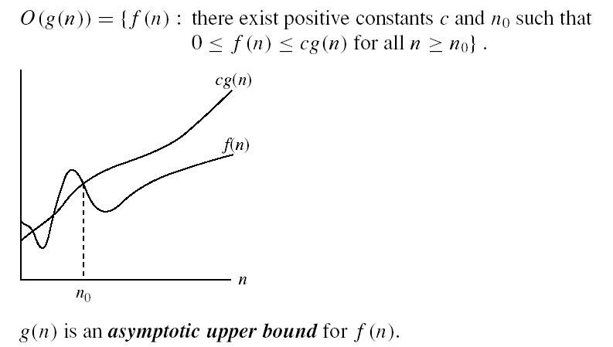
ASYMPTOTIC NOTATIONS

Slide 84
EXAMPLE
T(n)=10n³+5n+7 =O(n³).
Prove that if T(n) = 15n³ + n² + 4, T(n) = O(n³).
Prove that if T(n) = 15n³ + n² + 4, T(n) = O(n⁴)
Find upper bound of f(n)=2n³-2n²
F(n)=n
F(n)=410

Slide 85
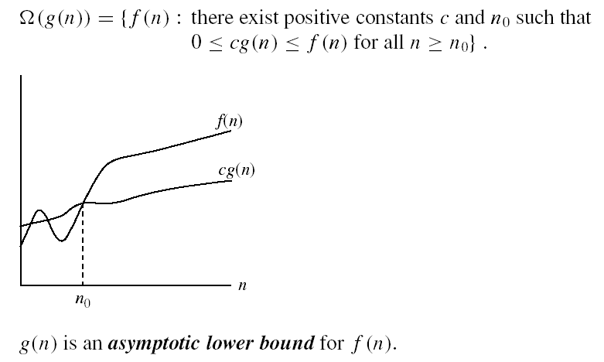

Slide 86
Prove that if T(n) = 15n³ + n² + 4, T(n) = Ω (n³)

Slide 87
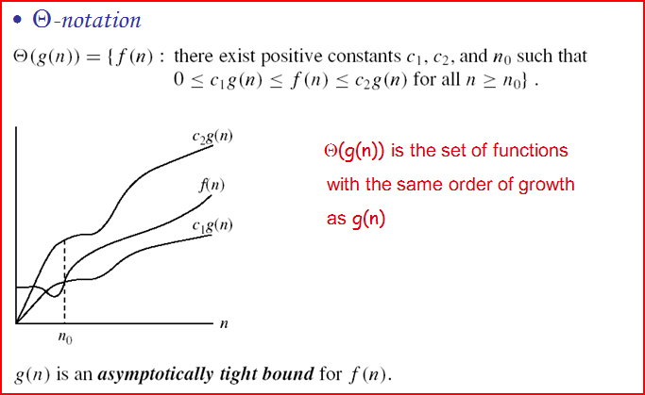

Slide 88
EXAMPLE
T(n)=10n³+5n²+17
10n3<=f1(n)<=(10+5+17)n³
C1=10 c2=32
For all n>=1 so n0=1
T(n)= Θ(n³⁾
Solve:T(n) = n³ + n log n =Θ(n³)
T(n)= n²/2-n/2

Slide 89
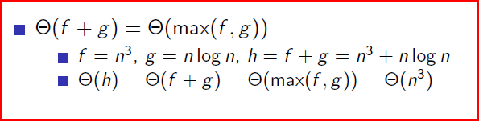
ASYMPTOTIC NOTATION PROPERTIES

Slide 90
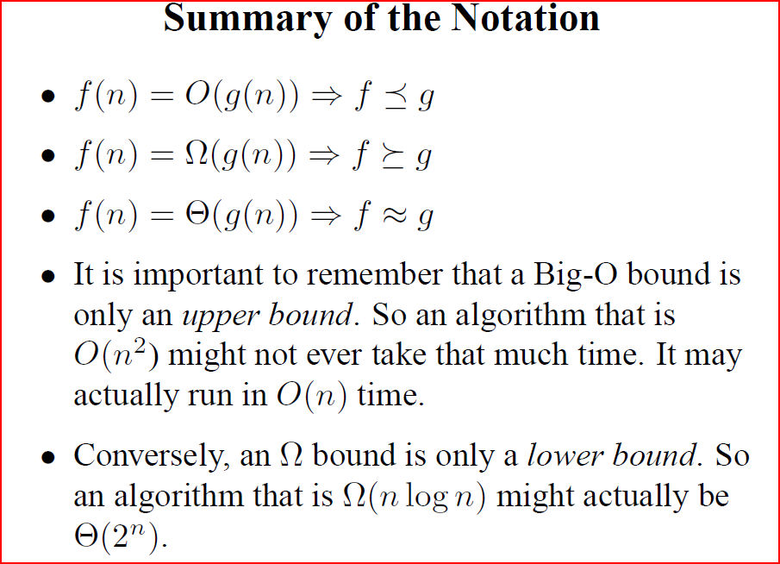

Slide 91
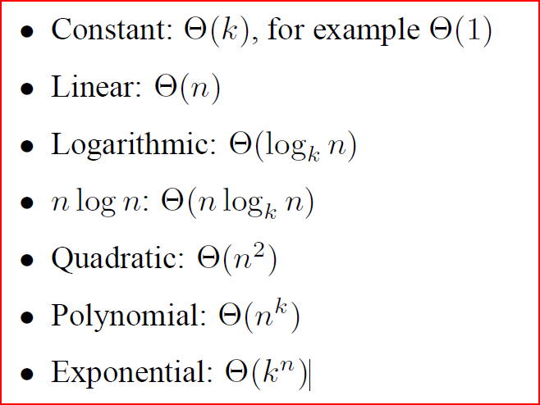
COMMON RATES OF GROWTH

Slide 92
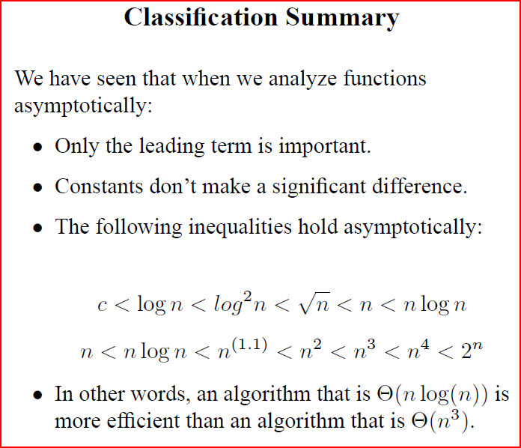

Slide 93
EXAMPLES & GUIDELINES
Loops:
for i=0 to n do
m=m+1 time=c*n=O(n)
Nested loops
for i=0 to n do
for j=0 to n do
m=m+1
Time=c*n*n=O(n²)

Slide 94
EXAMPLES & GUIDELINES
Consecutive statements
for i=0 to n do
m=m+1
for i=0 to n do
for j=0 to n do
m1=m1+1
Total time: c*n+ n*(c1*n)=O(n²)

Slide 95
EXAMPLES & GUIDELINES
If then else
if ( x > y )
x = x + 1
else
{ for ( i = 1 ; i <= n ; i++ )
  x = x + i;
  }

Slide 96
EXAMPLES & GUIDELINES
Logarithmic cmplexity
for i=1;i<n;
i=i*2
2^{k}=n
log(2^{k})=log(n)
Klog2=log(n)
K=log n

Slide 97
Example I: Find time complexity of following algorithm-
Algorithm areaTriangle( base, height, area)
{
Step
1.Read base, height
2.area=0.5*base*height
3.Print area
}

Slide 98
The algorithm takes 3 steps to complete. Thus T (n)=3
To satisfy the relation T (n)<=c*g (n),
the above relation can be written as
T (n)<=3 * 1
Comparing the above two relations we get
c=3, g (n)=1
Therefore, the above relation can be expressed as: T (n) = O (g (n))
T (n) = O (1)
We can say that the time complexity of above algorithm is O (1) i .e of order 1

Slide 99
Example II:
Algorithm sum(a[n], sum)
{
Step:
1. sum=0
2.Enter n.
3.for( i=0 to n )
3.1 Enter a[i]
3.2 sum = sum + a[i]
4.Print sum
}

Slide 100
The algorithm takes 2n+3 steps to complete. Thus T (n)=2n+3
To satisfy the relation T (n)<=c*g (n),
the above relation can be written as
T (n)<=2n+3
        T (n)<=2n+n
        T (n)<=3n
Comparing the above two relations we get
c=3, g (n)=n
Therefore, the above relation can be expressed as: T (n) = O (g (n))
T (n) = O (n)
We can say that the time complexity of above algorithm is O (n) i .e of order n

Slide 101
Find the time complexity
1. if ( x > y )
x = x + 1
else
{
  for ( i = 1 ; i <= n ; i++ )
  x = x + i;
  }
  .

Slide 102
Exercise
T(n) = 2527
T(n) = 8 * n + 17
T(n) = 5 * n² + 6
T(n) = 5 * n³+ n² + 2*n

Slide 103
DETERMINE FREQUENCY COUNT
probem1
i=1
While(i<=n){
x=x+1;
i=i+1;
Probem2
for (L=1;L<=n;L++)
for(j=1;j<=m;j++)
x=x+1;

Slide 104
DETERMINE FREQUENCY COUNT
for (L=1;L<=n;L++)
for(j=1;j<=L;j++)
x=x+1;
int process(int n)
{ if(n<=0)
return(0);
Else
Return(n+process(n-1))

Slide 105
LET US ANALYZE MATRIX MULTIPLICATION ALGORITHM
Algorithm matmul(n,n)
for i=1 to n
for j=1 to n
c[i][j]=0
for k=1 to n
c[i][j] = c[i][j]+a[i][k]*b[k][j]
end
end
end

Slide 106
DETERMINE FREQUENCY COUNT
for (i=1;i<=n;i++)
for (j=1;j<=i;j++)-
for (k=1;k<=j;k++)
X=X+1-;

Slide 107
SPACE COMPLEXITY
The space complexity of a program is the memory needs to run to completion.
The space requirement depends on
1)The fixed part that is independent of the characteristics of the input and outputs. This part typically includes the instruction space, space for simple variable ,space for constant.
2)The variable part: space needed for component variable whose size is dependent on particular instance, the space needed by reference variables, the recursion stack space.
S(P)=c + Sp(c is constant)
To analyze space complexity we will concentrate on Sp
,

Slide 108
EXAMPLES
Float Abc(float a,float b,float c)
{
Return a+b+b*c+(a+b-c)/(a+b);
}
S=O(1)

Slide 109
Float sum(float *a,const int n)
{
Float s=0;
For(int i=0;i<n;i++)
{s=s+a[i];
Return s;
}
S=O(1)

Slide 110
Float Rsum(float *a,const int n)
{
If(n=0) return 0;
Else return(Rsum(a,n-1)+a[n-1]))
}
S=0(n)

Slide 111
Manav Rachna College of Engg.

Slide 112
TYPES OF DATA STRUCTURE
Primitive and Non Primitive.
linear and Non linear DS
Static &dynamic
Persistent and Empherical DS
Sequential and Direct Access DS

Slide 113
PERSISTENT AND EMPHERICAL DS
Persistent data structure is a data structure that always preserves the previous version of itself when it is modified.
Such data structures are effectively immutable, as their operations do not (visibly) update the structure in-place, but instead always yield a new updated structure
A data structure is partially persistent if all versions can be accessed but only the newest version can be modified
. The data structure is fully persistent if every version can be both accessed and modified

Slide 114
ML-derived languages and Haskell, they support persistant DS
For eg: xs = [0, 1, 2] ys = [3, 4, 5]
Now concatenating the two lists:
zs = xs ++ ys results in the following memory structure:

Slide 115
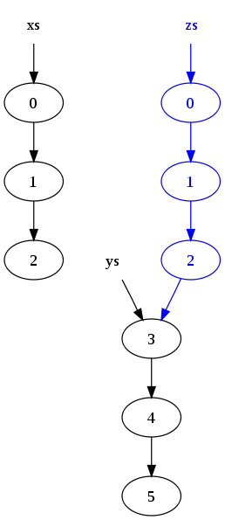
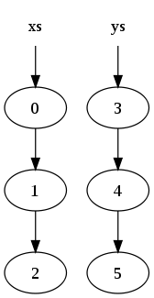
After concating

Slide 116
ALGORITHMIC STRATEGY
1.DIVIDE AND CONQUER
2.GREEDY STRATEGY

Slide 117
DIVIDE-AND-CONQUER
The strategy involves three steps at each level of recursion.
Divide:- Divide the problem into a number of sub problems.
Conquer:- Conquer the sub problems by solving them recursively. If the sub problem sizes are small enough, then just solve the sub problems in a straight forward manner.
Combine:- Combine the solutions to the sub problems to form the solution for the original problem.

Slide 118
CONTROL ABSTRACTION FOR DIVIDE AND CONQUER STRATEGY.
Algorithm DAndC (P)
{
1.if small(P) then return S(P) //termination condition
Else
{
2.Divide P into smaller instances P₁, P_{2,} P_{3…} P_{k} k≥1;
3.Apply DAndC to each of these sub problems.
4.Return Combine(DAndC(P₁), DAndC (P₂), …DAndC (P_{k})
}
}

Slide 119
COMPUTING TIME OF DANDC
T(n) = g(n) when n is small
= T(n₁)+ T(n₁)+ T(n₂)+…….+ T(n_{k})+ f(n) otherwise
T(n) denotes the time for DAndC on any input of size ‘n’.
g(n) is the time to compute the answer directly for small inputs.
f(n) is the time for dividing ‘P’ and combining the solutions of sub problems.

Slide 120
Binary Search: DIVIDE AND CONQUER STRATEGY
Binary search algorithm:
  Is used for searching large lists
  Searches the element in very few comparisons
  Can be used only if the list to be searched is sorted

Slide 121
Implementing Binary Search (Contd.)
Consider a list of 9 elements in a sorted array.
0
1
2
3
4
5
6
7
8
arr
9
13
17
19
25
29
39
40
47
Notes:
Ask students to answer this question and then come to the given example.

Slide 122
Implementing Binary Search (Contd.)
You have to search an element 13 in the given list.
0
1
2
3
4
5
6
7
8
arr
9
13
17
19
25
29
39
40
47
Notes:
Ask students to answer this question and then come to the given example.

Slide 123
Implementing Binary Search (Contd.)
Determine the index of the middlemost element in the list:
  Mid = (Lower bound + Upper bound)/2
  = (0 + 8)/2
  = 4
0
1
2
3
4
5
6
7
8
arr
9
13
17
19
25
29
39
40
47
Lower bound
Middle element
Upper bound
Notes:
Ask students to answer this question and then come to the given example.

Slide 124
Implementing Binary Search (Contd.)
13 is not equal to the middle element, therefore, again divide the list into two halves:
  Mid = (Lower bound + Upper bound)/2
  = (0 + 3)/2
  = 1
0
1
2
3
4
5
6
7
8
arr
9
13
17
19
25
29
39
40
47
Lower bound
Upper bound
Upper bound
Middle element
Middle element
Notes:
Ask students to answer this question and then come to the given example.

Slide 125
Implementing Binary Search (Contd.)
13 is equal to middle element.
Element found at index 1.
0
1
2
3
4
5
6
7
8
arr
9
13
17
19
25
29
39
40
47
Lower bound
Upper bound
Element found
Notes:
Ask students to answer this question and then come to the given example.

Slide 126
Implementing Binary Search (Contd.)
Write an algorithm to implement binary search algorithm.
  ALGORITHM BINARYSEARCH(A,N,Data)
  {//A is an array of N elements. Data is the element to be searched
  1.fori :=0 to N do
  read A[i]
  2.Enter the element to be searched, Data
  3. low := 0
  4. high := N – 1
  5.while(low<=high)
  {
  5.1 mid := (low + high)/2
  5.2 if (A[mid] = Data){
    5.2.1 write “Found”;
    5.2.2 exit ;}
  5.3. If( Data < A[mid])
  5.3.1 high := mid – 1
Notes:
Ask students to write an algorithm to implement bubble sorting. Given them 5-10 minutes to write the algorithm. Then show them the answer.

Slide 127
Implementing Binary Search (Contd.)
  5.4.If( Data > A[mid])
    5.4.1 Set low := mid + 1
    }
  6.Print “Not Found”
  7.Exit
  }
Notes:
Ask students to write an algorithm to implement bubble sorting. Given them 5-10 minutes to write the algorithm. Then show them the answer.

Slide 128
BINARY SEARCH USING RECURSION
  Algorithm binsearch(A, Low, high,Data,N)
  {//A is an array of N elements. Data is the element to be searched.
  1.fori :=0 to N do
  read A[i]
  2.Enter the element to be searched, Data
  3. low := 0
  4. high := N – 1
  5.if(low=high) then{
  5.1 if(Data=a[i])then return i;
  else return 0;}
  else
  5.1 mid := (low + high)/2
  5.2 if (A[mid] = Data) then return mid;

Slide 129
  5.3 else if(x<a[mid] then return
  binsearch(a,i,mid-1,Data,N)
  else return binsearch(a,mid+1,high,data,N);
  }

Slide 130
Determining the Efficiency of Binary Search
In binary search, with every step, the search area is reduced to half.
In the best case scenario, the element to be search is found at the middlemost position of the list:
  The number of comparisons in this case is 1.O(1)
In the worst case scenario, the element is not found in the list:
  After the first bisection, the search space is reduced to n/2 elements, where n is the number of elements in the original list.
  After the second bisection, the search space is reduced to n/4 elements, that is, n/2² elements.
  After i^{th} bisections, the number of comparisons would be n/2^{i} elements.
  O(logn)
Notes:
In this slide you need to show the calculation to determine the sum of an arithmetic progression for bubble sort algorithm. Refer to student guide.

Slide 131
Just a minute
In ___________ search algorithm, you begin at one end of the list and scan the list until the desired item is found or the end of the list is reached.
Answer:
  linear
Notes:
In this slide you need to show the calculation to determine the sum of an arithmetic progression for bubble sort algorithm. Refer to student guide.

Slide 132
Just a minute
To implement __________ search algorithm, the list should be sorted.
Answer:
  binary
Notes:
In this slide you need to show the calculation to determine the sum of an arithmetic progression for bubble sort algorithm. Refer to student guide.

Slide 133
GREEDY STRATEGY

Slide 134
PRINCIPAL
Basic idea
Find the optimal solution piece by piece.
Iterative make decision one by one and hope everything works out well at the end.
Once the decision is made then choice should not get changed for the subsequent steps.

Slide 135
OPTIMIZATION PROBLEMS
For most optimization problems you want to find, not just a solution, but the best solution.
A greedy algorithm sometimes works well for optimization problems. It works in phases. At each phase:
  You take the best you can get right now, without regard for future consequences.
  You hope that by choosing a local optimum at each step, you will end up at a global optimum.

Slide 136
EXAMPLE: COUNTING MONEY
Suppose you want to count out a certain amount of money, using the fewest possible bills and coins
A greedy algorithm to do this would be:
At each step, take the largest possible bill or coin that does not overshoot
  Example: To make $6.39, you can choose:
    a $5 bill
    a $1 bill, to make $6
    a 25¢ coin, to make $6.25
    A 10¢ coin, to make $6.35
    four 1¢ coins, to make $6.39
For US money, the greedy algorithm always gives the optimum solution

Slide 137
GENERAL PRINCIPAL
The choice that seems best at the moment is the one we go with.

Slide 138
GREEDY ALGORITHM FAILURE
In some (fictional) monetary system, “krons” come in 1 kron, 7 kron, and 10 kron coins
Using a greedy algorithm to count out 15 krons, you would get
  A 10 kron piece
  Five 1 kron pieces, for a total of 15 krons
  This requires six coins
A better solution would be to use two 7 kron pieces and one 1 kron piece
  This only requires three coins
The greedy algorithm results in a solution, but not in an optimal solution

Slide 139
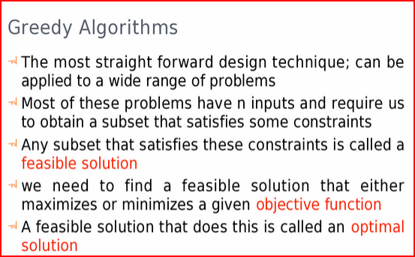

Slide 140
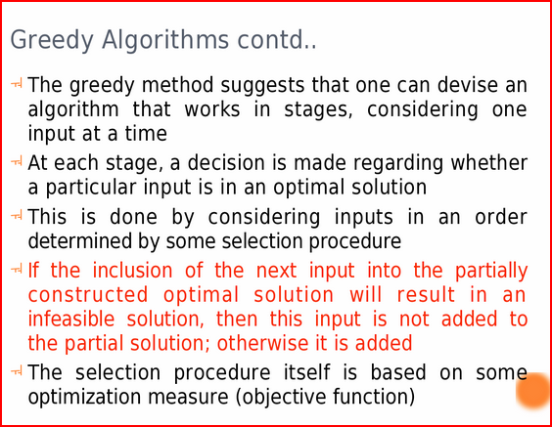

Slide 141
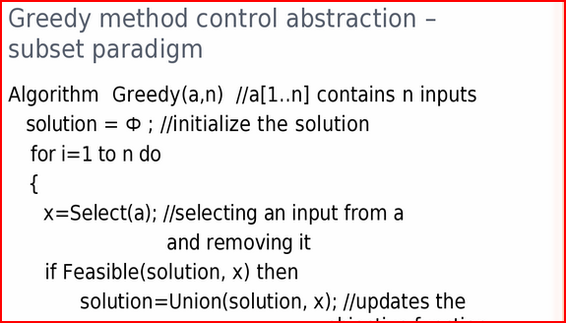
CONTROL ABSTRACTION

Slide 142


Slide 143
Note terms :-
Feasible solution
Optimal solution
Objective function

Slide 144
Subset paradigm
At each step decision is made about the input to find optimal solution.
Ordering paradigm
The decision is made by considering the input in some order. E.g. Single source shortest path algorithm

Slide 145
KNAPSACK PROBLEM
Problem
Input:
n objects.
each object i has a weight wi and a profit Pi
Knapsack : M
Outpuţ
Fill up the Knapsack s.t. the total profit is maximized.
Feasible solution: (x1,…….Xn)

Slide 146
FORMALLY
Let xi be the fraction of object i placed in the Knapsack,
O ≤xi≤ 1. For 1≤i ≤n.
Then :
P = maximize ∑ pixi for 1≤i ≤n
Subject to ∑wixi ≤ m for 1≤i ≤n

Slide 147
EXAMPLE
  n = 3, M = 20,
  (p₁, p₂, p₃) = (25, 24, 15)
  (w₁, w₂, w₃) = (18, 15, 10)
Sol:
Largest-profit strategy(Greedy method)
Pick always the object with largest profit.
If the weight of the object exceeds the remaining Knapsack capacity, take a fraction of the object to fill up the Knapsack

Slide 148
The feasible solution is (1, 2/15,0)
P=25+2/15*24 =25+3.2=28.2
2nd solution :Smallest-weight strategy
be greedy in capacity: do not want to fill the knapsack quickly.
̧Pick the object with the smallest weight.
If the weight of the object exceeds the remaining
knapsack capacity, take a fraction of the object.

Slide 149
Feasible solution : (0,2/3,1)
P = 15+ 2/3.24
= 15+ 16 = 31
Solution 3:Largest profit-weight ratio strategy
Order profit-weight ratios of all objects.
Pi/wi≥(pi+1)/(wi+1) for 1 ≤i ≤n-1
Pick the object with the largest p/w
If the weight of the object exceeds the remaining
knapsack capacity, take a fraction of the object.

Slide 150
  p₁/w₁ = 25/18 = 1.39
  p₂/w₂ = 24/15 = 1.6
  p₃/w₃ = 15/10 = 1.5
  Optimal solution: x₁ = 0, x₂ = 1, x₃ = ½=(0,1,1/2)
total profit = 24 + 7.5 = 31.5

Slide 151
GREEDY-FRACTIONAL-KNAPSACK (M,N)
Greedy-fractional-knapsack (m,n)
//p[1:n]and w[1:n] contains profits and weights ordered such //that p[i]/w[i]>p[i+1]/w[i+1],m is knapsack size and x[1:n] is //solution vector.
{FOR i =1 to n do x[i] =0;
U=m;
for i=1ton do
{
if w[i]>U then break;
X[i]=1.0;U=U-w[i];
}
if (i<=n)then x[i]=U/w[i];
}

Slide 152
ANALYSIS
if the items are already sorted into decreasing order of vi / wi
then the for-loop takes O(n) time
Therefore, the total time including the sort is in O(n log n) as quicksort’s average time complexity is O(nlogn).

Slide 153
Relationship between data, data structures and algorithm.
From problem to program.

Slide 154
ADT-ABSTRACT DATA TYPE
Tool for specifying logical properties of data type.
It is a collection of values and set of operations on those values.
The definition of ADT is not concerned with the implementation details at all.

Slide 155
abstract typedef<integer,integer>Rational;
condition Rational[1]!=0; /*value defination*/
/*operator defination*/
abstract Rational makerational(a,b)
int a,b;
Precondition b!=0;
Postcondition makerational[0]=a;
makerational[1]=b;
abstract Rational add(a,b)
Rational a,b;
Postcondition add[0]=a[0]*b[1]+b[0]*a[1];
add[1]=a[1]*b[1];

Slide 156
abstract Rational mul(a,b)
Rational a,b;
Postcondition mul[0]=a[0]*b[0];
mul[1]=a[1]*b[1];
abstract Rational equal(a,b)
Rational a,b;
Postcondition equal==(a[0]*b[1]==b[0]*a[1])

Slide 157
RECURRENCES AND RUNNING TIME
An equation or inequality that describes a function in terms of its value on smaller inputs.
T(n) = T(n-1) + n
Recurrences arise when an algorithm contains recursive calls to itself
What is the actual running time of the algorithm?
Need to solve the recurrence
  Find an explicit formula of the expression
  Bound the recurrence by an expression that involves n

Slide 158
EXAMPLE RECURRENCES
T(n) = T(n-1) + n Θ(n²)
T(n) = T(n/2) + c Θ(lgn)
T(n) = T(n/2) + n Θ(n)
T(n) = 2T(n/2) + 1 Θ(n)

Slide 159
LINEAR RECURRENCE RELATIONS

Slide 160
SOLVING RECURRENCES
T(n) = c + T(n/2)
T(n) = c + T(n/2)
= c + c + T(n/4)
= c + c + c + T(n/8)
Assume n = 2^{k}
T(n) = c + c + … + c + T(1)
= clgn + T(1)
= 0(lgn)
T(n/2) = c + T(n/4)
T(n/4) = c + T(n/8)
k times

Slide 161
T(n) = n + 2T(n/2)
T(n) = n + 2T(n/2)
= n + 2(n/2 + 2T(n/4))
= n + n + 4T(n/4)
= n + n + 4(n/4 + 2T(n/8))
= n + n + n + 8T(n/8)
… = in + 2^{i}T(n/2^{i})
= kn + 2^{k}T(1)
= nlgn + nT(1) =0(nlgn)
Assume: n = 2^{k}
T(n/2) = n/2 + 2T(n/4)

Slide 162
SOLVE
T(n)=9T(n/3)+4n6
T(n)=7t(n/2)+18n2
T(n) = 2T(n/2) + n
T(n) = 2T( sqrt(n) ) + lgn
T(n) = 3T(n/4) + cn²

Slide 163
SOLVING HOMOGENEOUS EQUATIONS
As done in class

